Slide 1

ThutoFunds – Gamified Bursary Discovery
Unlocking Opportunities, One Fun Stage at a Time!

Slide 2
Agenda
01
02
03
The Challenge & Our Vision
Introducing ThutoFunds
Gamified Journey Explained
Why finding bursaries is so tough for South African students.
A new, engaging way to connect students with funding.
Dive into the Mario-style map and its exciting stages.
04
05
The Magic Behind the Scenes
Impact & Next Steps
How AI ensures perfect bursary matches.
Transforming lives and educational outcomes.

Slide 3

The Bursary Maze: A Common Frustration
For many South African students, securing a bursary or scholarship is a game-changer. Yet, the current process is often a daunting maze of:
Endless forms: Repetitive, tedious, and time-consuming.
Information overload: Sifting through countless irrelevant options.
Missed opportunities: Not knowing which bursaries they actually qualify for.
"Finding the right bursary feels like looking for a needle in a haystack. I just want to focus on my studies!"

Slide 4
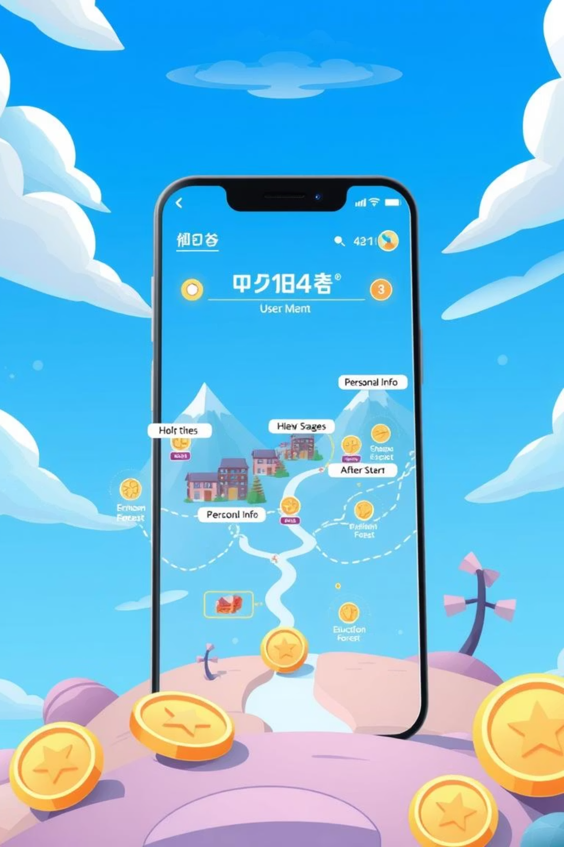
ThutoFunds: Making Funding Fun!
We've transformed the often-dreaded bursary application process into an engaging, interactive, and rewarding adventure!

Slide 5



Your Journey on the ThutoFunds Map
Village of Personal Info
Education Forest
Financial Castle
Start your quest by entering basic details: name, email, and province.
Share your academic path: field of study, GPA, and current year.
Reveal your financial needs: household income and funding requirements.
Each stage is designed to feel like a level in your favorite adventure game!

Slide 6

Level Up Your Application: Rewards & Milestones
Collect Coins
Earn virtual coins for every piece of information you provide, turning data entry into a treasure hunt!
Unlock Badges
Achieve milestones and earn cool badges like "First 3 fields completed 🍄" – a fun nod to classic gaming!

Slide 7

The Boss Battle & Beyond!
Conquer the Boss
Submit your completed profile in a thrilling 'Boss battle', celebrating your journey to success!
AI-Powered Matches
After your submission, our smart system takes over, using AI to find your perfect bursary matches.
No more manual searching – just smart, personalized recommendations!

Slide 8





The Brains Behind the Bursary Matches
Connect to Gemini
Match Bursaries
Send data to Google Gemini AI
Return best scholarship matches
Cloud Function
Analyze Data
Securely transmit student profile
Intelligently evaluate eligibility
Our Firebase Cloud Function securely transmits your profile to Google's Gemini AI, which then intelligently analyzes your information against a vast database of bursaries and scholarships.

Slide 9



Why ThutoFunds Matters: Real Impact
Empowering Students
Increased Access
Brighter Futures
Makes the application process accessible and less intimidating for all.
Connects more students with the funding they need to pursue higher education.
Directly contributes to a more educated and skilled South African workforce.
We're not just finding bursaries; we're building a pathway to success!

Slide 10

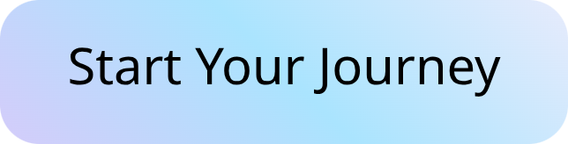

Join the ThutoFunds Adventure!
For Students:
For Partners & NGOs:
Get ready to embark on your bursary quest! Sign up today and let ThutoFunds guide you to your academic funding.
Collaborate with us to expand our impact and reach more students. Let's transform education together!

